Slide 1
CSCI 558L Lecture 5: Network Performance
Internetworking and Distributed Systems Laboratory
Young Cho
Department of Computer Science
University of Southern California

Slide 2
Bandwidth Metrics
Network Measurement Working Group
Bandwidth Capacity
Achievable Bandwidth (Throughput)
Bandwidth Utilization
Available Bandwidth
Bulk Transfer Capacity (RFC 3148)
BTC = data_sent / elapsed_time
i.e. the throughput of a persistent TCP transfer
Range of Metric Usage
End-to-end
Hop-to-hop

Slide 3
Bandwidth Metrics
Bandwidth Capacity
The maximum amount of data per time unit that the link or path has available, when there is no competing traffic
The link with the minimum transmission rate determines the capacity
Achievable bandwidth (Throughput)
The maximum amount of data per time unit that a link or path can provide to an application, given the current utilization, the protocol and operating system used, and the end-host performance capability and load
Hardware/software configuration on the end hosts actually limit the achievable bandwidth delivered to the application.
Bandwidth Utilization
The aggregate capacity currently being consumed
Available Bandwidth
Available Bandwidth = Bandwidth Capacity – Bandwidth Utilization

Slide 4
Bulk Transfer Capacity
Maximum Bulk Transfer
Sending as much packets as possible, limiting other traffic
Simulating “steady state”
Persistent flow, taking considerable time and overhead
Assumption
Ideal TCP implementation
Actually, this doesn’t exist
Ultimately, a variant of achievable bandwidth.

Slide 5
Passive vs. Active measurement
Active Measurement
Tools actively send probing packets into the network
Overhead introduced
Passive Measurement
Tools monitors the passing traffic without interfering
Less reliable than active – cannot selectively measure all aspect of bandwidth

Slide 6
Measurement Techniques
Receiver-based (end-to-end)
Usually use the one-direction TCP stream to probe the path bandwidth
Advantage
More accurate than sender-based technique
Disadvantage
Difficult to deploy
The clock have to be synchronized at two ends
Sender-based (echo-based)
Force the receiver to reply the ICMP query, UDP echo or TCP-FIN
Advantage
Flexible deployment
Clock needn’t synchronized at two ends.
Disadvantage:
ICMP and UDP echo packets are rate-limited or filtered out by some routers
Round-trip is influenced by cross-traffic than that of one-way delay
Response packets may come back through a different path

Slide 7
Measurement Technique Examples
Packet Dispersion technology
Packet pair and packet train
Self-Loading Periodic streams (SLOPS)
Variable Packet Size (VPS) technology
VPS even/odd
Tailgating technique

Slide 8
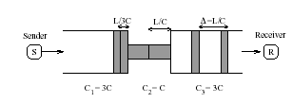
Packet Dispersion Technique
Sender sends two same-size packets back-to-back from source to sink.
The packets will reach the sink dispersed by the transmission delay of the bottleneck links if there is no cross traffic
Measuring the dispersion can infer the bottleneck link bandwidth capacity.
Note: Bottleneck link can refer to the link with smallest transmission rate, it’s also can refer to the link with minimum available bandwidth. We refer the bottleneck link to the first case.

Slide 9
Packet Dispersion Technique
Tool Name | Method | Protocol | Metrics
bprobe | Packet pair | ICMP | Bandwidth Capacity
cprobe | Packet pair | ICMP | Bandwidth utilization
Netest | Packet pair | UDP | Bandwidth capacity
Pathrate | Packet pair, packet train | UDP | Bandwidth capacity
Pipechar | Packet train | UDP | Available bandwidth
Sprobe | Packet pair | TCP | Bandwidth capacity
FOR MORE INFO...
Bprobe and cprobe http://cs-people.bu.edu/carter/tools/Tools.html
Nettest http://www-didc.lbl.gov/pipechar
Pathrate http://www.cc.gatech.edu/fac/Constantinos.Dovrolis
Pipechar http://www-didc.lbl.gov/pipechar
SProbe http://sprobe.cs.washington.edu

Slide 10
Self-Loading Periodic Streams(SLOPS)
Sender sends series of packets to the sink at the rate of larger than the bottleneck link available bandwidth
Every packets get a timestamp at sender side.
Compare the difference of successive packets timestamp and their arrival times to infer the available bandwidth.
Rate-adjustment adaptive algorithm to converge to the available bandwidth.
FOR MORE INFO...
Pathload http://www.cc.gatech.edu/fac/Constantinos.Dovrolis

Slide 11
Variable Packet Size (VPS) Technique
Step1
Sender set TTL=1
send out the packet
wait for the ICMP TTL-exceeded packet
Step2
Upon receiving ICMP
Estimate the RTT multiple times for various size packets
The minimum RTT of various packets are believed to be the valid sample.
Step3
The first link capacity is C=1/β , β is slope of RTT graph.
Set the TTL=2,3…n, repeat the process of step1 to 3, to Calculate the C=1/ βi – βi-1

Slide 12
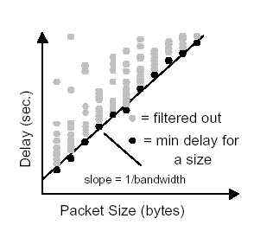
VPS technique cont.

Slide 13
VPS Technology
Tool Name | Protocol | Metrics | Path/Per-link
bing | ICMP | Bandwidth capacity, loss, delay | Path
clink | UDP | Bandwidth capacity, Loss | Path
Pchar | UDP, ICMP | Bandwidth capacity, Loss, delay | Per-link
Nettimer | TCP | Bandwidth capacity | Per-link
pathchar | UDP, ICMP | Bandwidth capacity, Loss, delay | Per-link
FOR MORE INFO...
Bing http://www.cnam.fn/reseau/bing.html
Clink http://rocky.wellesley.edu/downey/clink/
Pchar http://www.emplyees.org/~bmah/software/pchar
Nettimer http://mosquitonet.stanford.edu/~laik/project/nettimer
Pathchar ftp://ftp.ee.lbl.gov/pathchar/

Slide 14
TCP Simulation and Path Flooding
TCP simulation
Simulates the TCP of using slow-start algorithm
Path flooding
Injects TCP/UDP packets into the net as fast as possible within the specific time.
Associated with Bulk Transfer Capacity

Slide 15
TCP Simulation and Path Flooding
Tool Name | Method | Protocol | Metrics | Path/Per-link
TReno | TCP simulation | UDP, ICMP | BTC | Path
ttcp | Path flooding | TCP, UDP | Achievable bandwidth | Path
iperf | Path flooding | TCP, UDP | Bandwidth capacity, Loss | Path
Netperf | Path flooding | TCP, UDP | BTC, delay throughput | Path
FOR MORE INFO...
TReno http://www.psc.edu/networking/treno_info.html
Iperf http://dast.nlanr.net/Project/Iperf
Netperf http://www.netperf.org/netperf/NetperfPage.html
ttcp ftp://ftp.arl.mil/pub/ttcp/

Slide 16
Laboratory 4
Purpose
Learn to use iperf to measure performance
Learn to configure and use DETER
Learn the effects of Bandwidth and Delay
Learn to adjust network specific OS kernel configurations to increase performance
Submission
Create a document with tables, graphs, and paragraphs describing the answers to all the questions
Submit via moodle

Slide 17
IPERF
Website
http://dast.nlanr.net/Projects/Iperf/
Format
server side
iperf -s -%
Iperf -s -V
client side
iperf -c <server address> -%
iperf -c <server IPv6 address>

Slide 18
Command line option
-s : Run in server mode
-D : Run the server as a daemon
-w
TCP : window size (Default ：8K for Windows 32.5K for FreeBSD)
UDP: buffer size (Default ：8K for Windows 9K for FreeBSD)
-f
Specifying the format to print bandwidth numbers in
'b' = bits/sec 'B' = Bytes/sec
'k' = Kbits/sec 'K' = KBytes/sec
'm' = Mbits/sec 'M' = MBytes/sec
'g' = Gbits/sec 'G' = GBytes/sec
(Default) 'a' = adaptive bits/sec 'A' = adaptive Bytes/sec

Slide 19
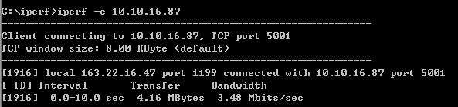
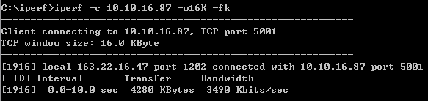
Command line option

Slide 20
Command line option
-l: The length of buffers to read or write.
( Default 8KB for TCP, 1470 bytes for UDP)
Buffer Delay is unfavorable to Real-Time Application.
-i: Sets the interval time.
-u: Use UDP rather than TCP.
-C: Compatibility mode allows for use with older version of iperf
-N: nodelay

Slide 21
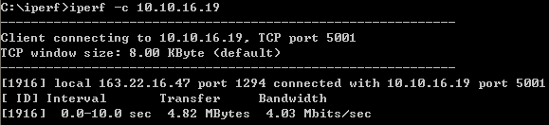
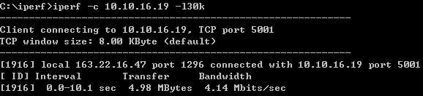
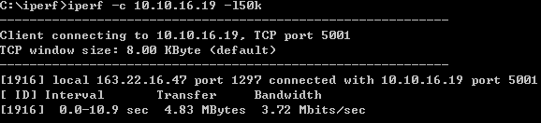
Command line option

Slide 22
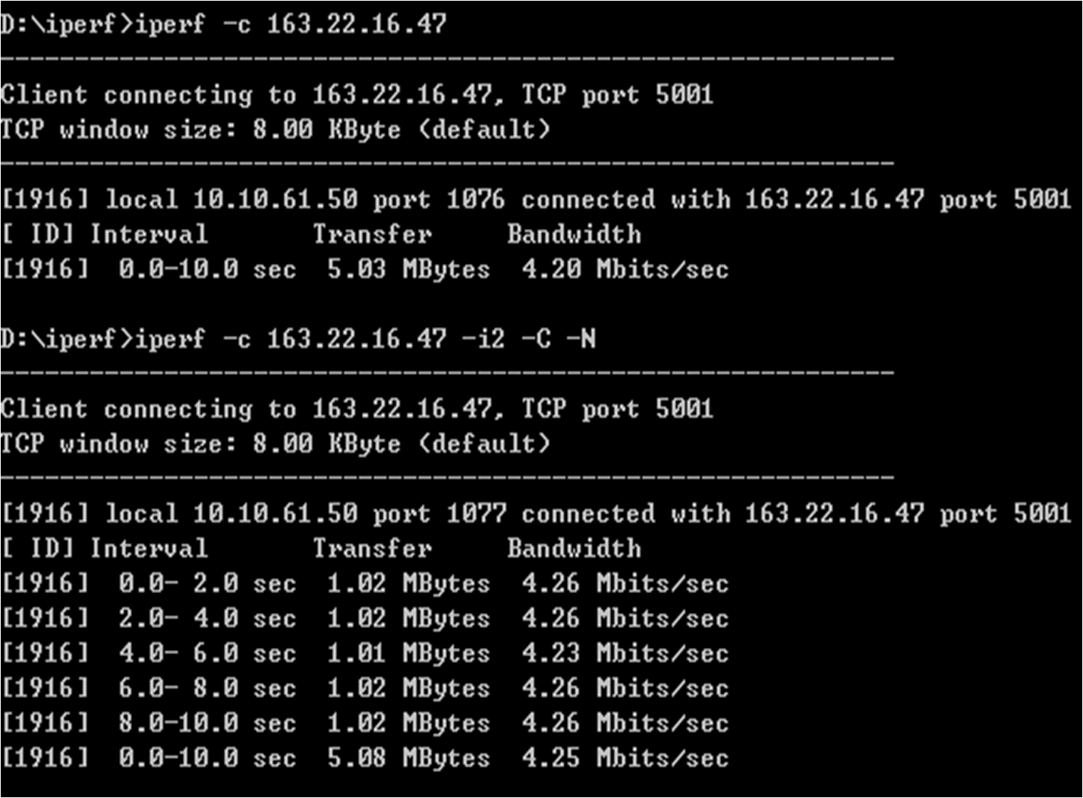
Command line option

Slide 23
Command line option
Client specific options
-b：for UDP, bandwidth to send at in bits/sec.
(default 1 Mbit/sec, implies -u)
-n：number of bytes to transmit (instead of -t)
-t：time in seconds to transmit for (default 10 secs)

Slide 24
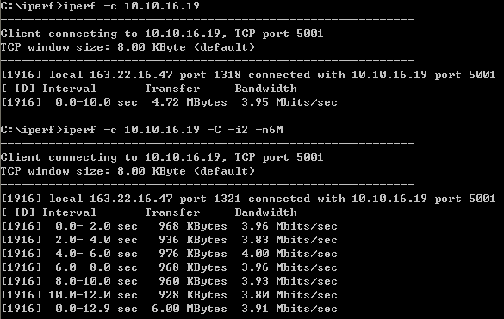
Command line option

Slide 25
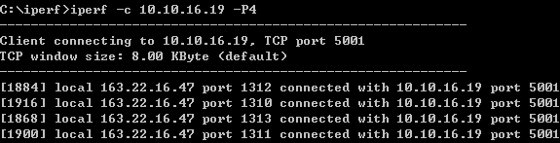
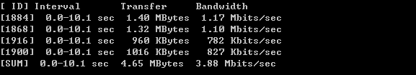
Command line option
-P：number of parallel client threads to run .

Slide 26
Command line option
-B: Bind to host
useful on multi-homed hosts, which have multiple network interfaces.
Iperf in UDP server mode
Join to a multicast group
Addresses in the range 224.0.0.0 to 239.255.255.255

Slide 27
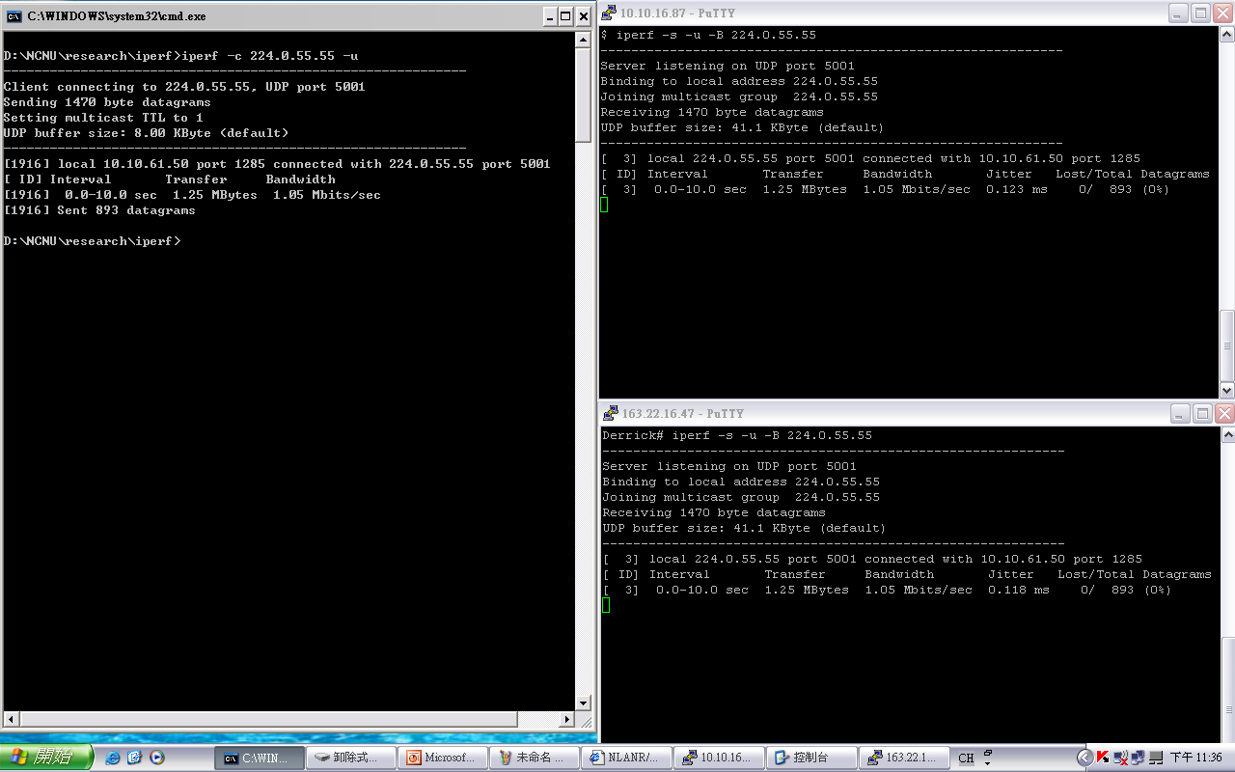

Slide 28
Laboratory 4: Reliable File Transfer
The First Group Project
Competitively scored
Purpose
Learn to configure and use DETER
Collaborative learning
Understanding through a realistic application
Submission
Create a document describing the answers
Submit via Moodle
Submit system performance results via forum

Slide 29
Problem: TCP congestion control
Approach: increase transmission rate (congestion window size), probing for usable bandwidth, until loss occurs
additive increase: increase CongWin by 1 MSS every RTT until loss detected
multiplicative decrease: cut CongWin in half after loss
congestion window size
Saw tooth
behavior: probing
for bandwidth

Slide 30

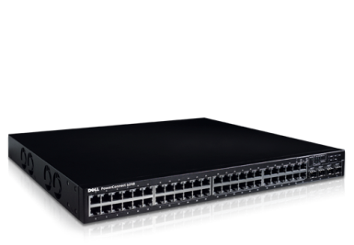

Laboratory 4: Fast and Reliable FTP
Part A
Each group split into 2 subgroups
Competing within each group
Demo both methods on Sept 17th
Full credit for >20 Mbps on 100Mbps/200ms/20% loss
Automated script to determine winner
Extra credit, if your script is used in Part B
Daily progress must be posted on the forum!
100 Mbps
200ms RTT
20% packet loss

Slide 31
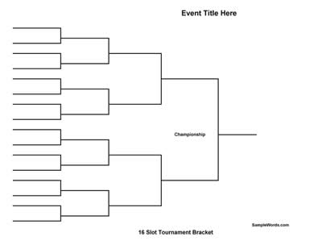
Laboratory 4: Fast and Reliable FTP
Part B
Each group merge the best techniques
Tournament Qualification: >40 Mbps (full credit)
The Tournament
September 24th: tournament at demo
September 25th: the finalists compete in class
The winner(s) will get extra credit
CSCI 558L FTP Tournament

Slide 32
Next
Next Lecture
Transport Layer
Laboratory 4: Fast and Reliable FTP
Part A – Due Sept 15th, demo 17th
Part B – Demo Sept 24th ,Finalists Compete 25th
Reading Assignment
Gerla, M. et al, "Generalized Window Advertising for TCP Congestion Control", UCLA Tech Report, Feb 1999.
Due September 15 at 11:55pm

